Slide 1


Insights and Predictions from H-1B Dataset - Milestone 2
Gaurav Hasija
Kanishka Jain
Bhavesh Bellara
Danish Mir

Slide 2

Data Cleaning & Processing
Combining data from 5 datasets into a single dataset
Removing redundancies
Removing outliers
Encoding the dataset to answer research question
Notes:
At the end of milestone 1, we had our H1B dataset divided into 5 parts based on years. Our first goal was to combine the data under these 5 different datasets into a single dataset to make it easier in conducting further studies on it. While combining, we identified there were a lot of uncommon rows and rows with the same data but different column names. We standardized this and combined the entire data under a single dataset.
Next stage involved cleaning the data of redundancies like missing values, incorrect entries, etc. We used techniques like mean, mode to identify these redundancies and ultimately dropped these values to have a clean dataset.
The final step in getting the dataset ready for analysis was encoding the data to a standard format to make it easier to answer research questions. For example, we had to standardize the wage column as the entries were of different types like bi-weekly, monthly and annual wage.

Slide 3

Research Questions
Predict the time duration in days it takes for a case to be certified or denied
Predict the case decision
Predict whether the agent is present or not for the case
Predict Threshold Hourly Salary based on Employee hourly salary and Occupation

Slide 4
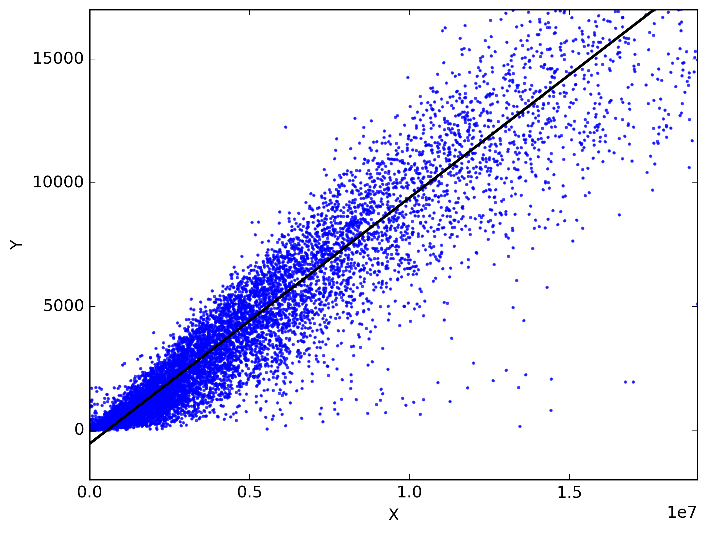
Linear Regression
Research Question(s) answers
Predict the time duration in days it takes for a case to be certified or denied.
Predict Threshold Hourly Salary based on Employee hourly salary and Occupation.

Slide 5
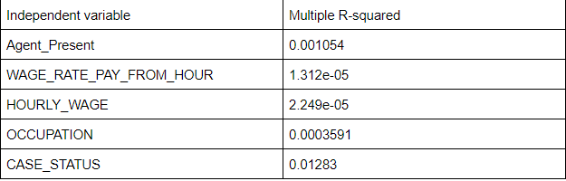
Linear Regression
Predict the time duration in days it takes for a case to be certified or denied.
On analysis we found that none of the independent variables generated accurate predictions for DURATION.

Slide 6
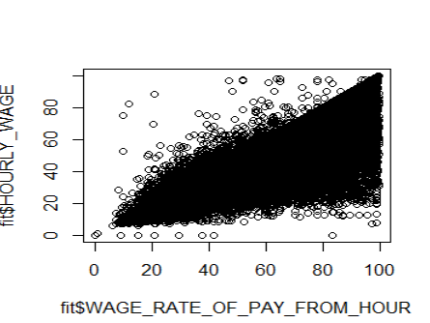
Linear Regression
Predict Threshold Hourly Salary based on Employee hourly salary and Occupation.
Wage_Rate_Of_Pay_From_Hour could be used to generate accurate predictions

Slide 7
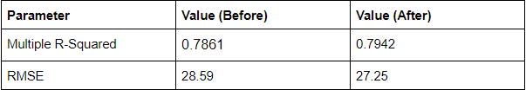
Linear Regression
Multivariate Regression
Combined Independent variables Occupation and Agent_Present with Dependent variable Hourly_Wage.
The results improved after combining OCCUPATION and AGENT_PRESENT with WAGE_RATE_FROM_HOUR

Slide 8
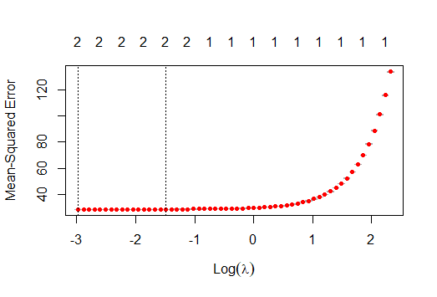
Linear Regression
Regularization
When the above experiments were repeated by adding regularization, the correlation remained the same. This suggests that although regularization allowed us to build a simpler model in which we used a few predictive features, the model did not improve.

Slide 9
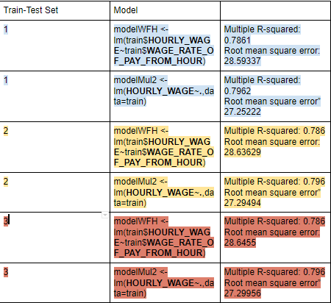
Linear Regression
Random train and test datasets
We can see that after choosing random test and training samples, the results are almost the same.

Slide 10

Logistic Regression
Predict the case decision.
Predict whether the agent is present or not for the case.

Slide 11
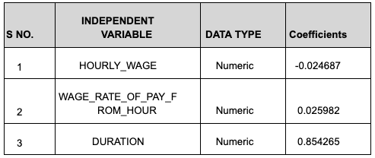
Logistic Regression
Case Status Prediction:
On applying the model, we found below features to be the significant independent variables.

Slide 12
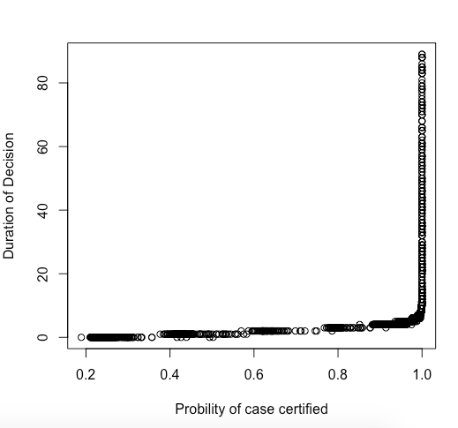
Logistic Regression
Case Decision Prediction Outcome:
Probability of rejection is maximum when decision duration is extremely small(less than 10).
Also case status is loosely linked with wage, as wage increases probability of getting H1b certified increases.

Slide 13
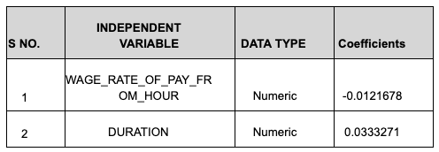
Logistic Regression
Agent Presence Prediction:
On applying the model, we found below features to be the significant independent variables.

Slide 14
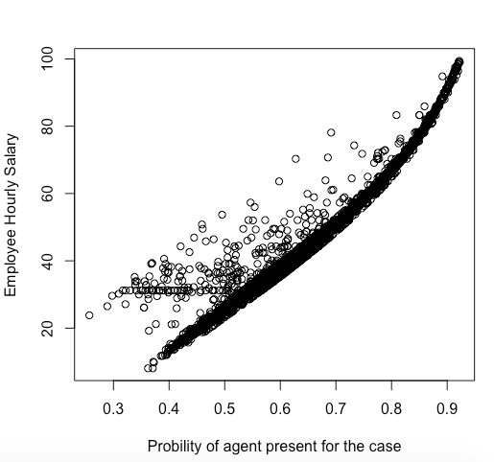
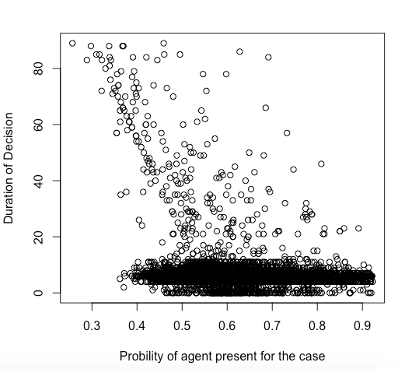
Logistic Regression
Agent Presence Prediction Outcome:
Probability of agent being present increases with the employees hourly wage, it shows high paid employees are usually given attorneys by the company for their H-1B case.
Probability of agent being present decreases with the duration, it shows to get the results of H-1B quickly, agent needs to be hired for the case.

Slide 15
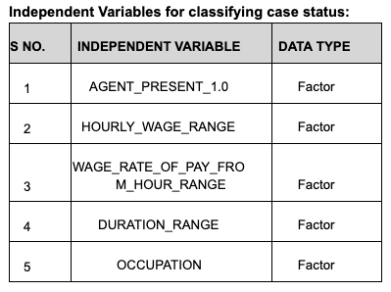
Naive Bayes Classification
Case Status Prediction :
On applying the model, we found below features to be the significant independent variables but with low conditional Probabilities.

Slide 16
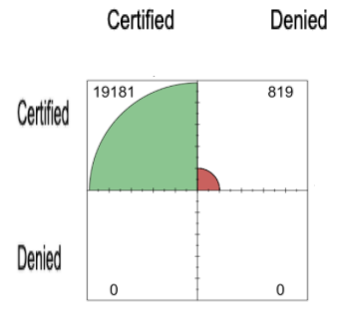
Naive Bayes classification
Case Status Prediction Outcome:
As per the confusion matrix reported in question 2 part b, model is unable to classify the case status correctly. As all the classification leads to majority class.
Undersampling was performed by equally dividing the true and false sets which did not improve classification efficiency.
Confusion Matrix:

Slide 17
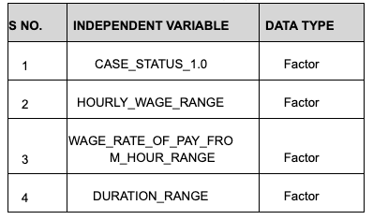
Naive Bayes Classification
Agent Presence Prediction :
On applying the model, we found below features to be the significant independent variables but with low conditional Probabilities.

Slide 18
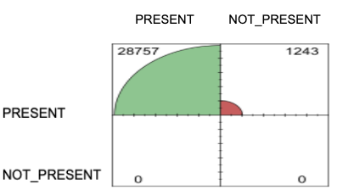
Naive Bayes classification
Agent Presence Prediction Outcome:
As per the confusion matrix reported in question 2 part b, model is unable to classify the agent present correctly. As all the classification leads to majority class.
Undersampling was performed by equally dividing the true and false sets which did not improve classification efficiency.
Confusion Matrix:

Slide 19
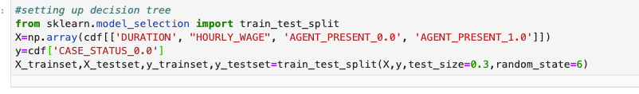

Decision tree 1
Predict the case decision
Dependent variables: 'DURATION', "HOURLY_WAGE", 'AGENT_PRESENT_0.0', 'AGENT_PRESENT_1.0'
Independent variable: CASE_STATUS_0.0

Slide 20
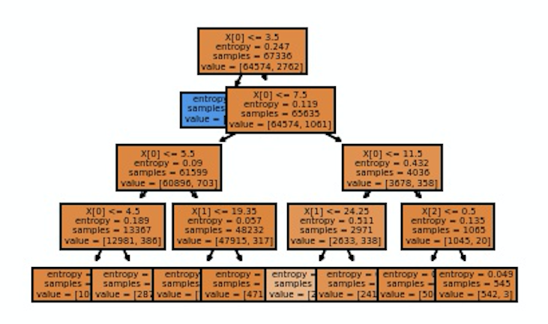
Random Forest

Slide 21
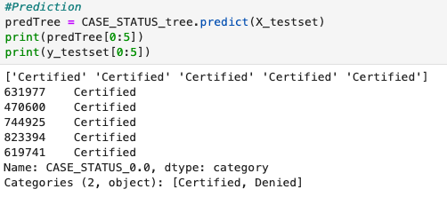
Prediction

Slide 22
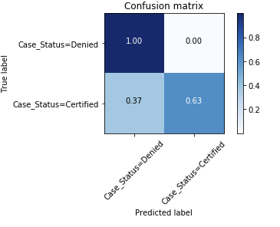
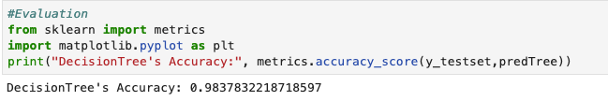
Evaluation

Slide 23
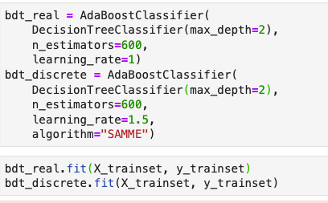
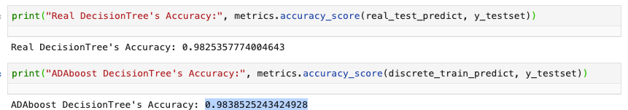
Boosting

Slide 24
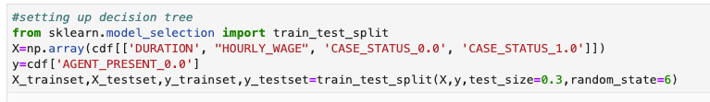
Decision tree 2
Predict whether the agent is present or not for the case
Dependent variables: 'DURATION', "HOURLY_WAGE", 'CASE_STATUS_0.0 ', 'CASE_STATUS_1.0 '
Independent variable: AGENT_PRESENT_0.0

Slide 25
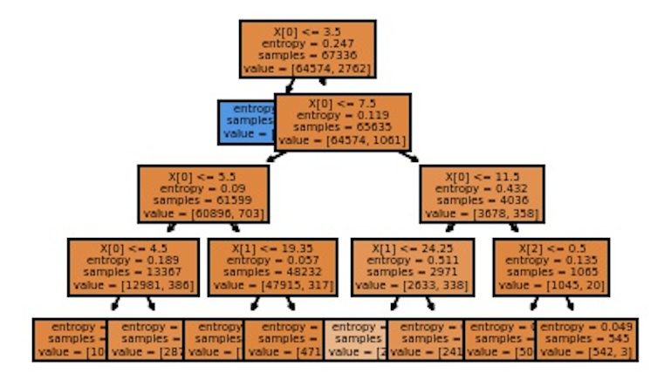
Random Forest

Slide 26
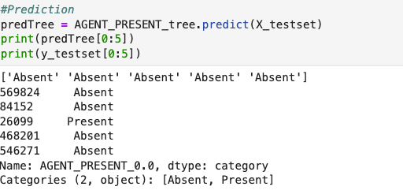
Prediction

Slide 27
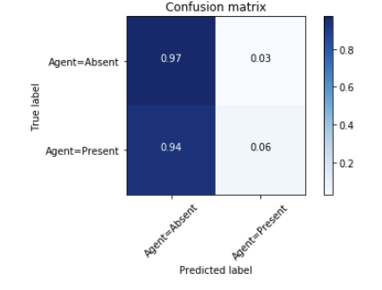
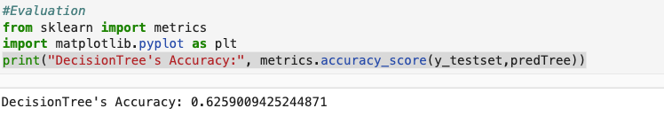
Evaluation

Slide 28
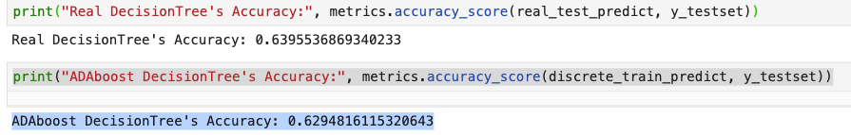
Boosting

Slide 29
Conclusion
Predict the case decision- DECISION TREE
Predict whether the agent is present or not for the case- LOGISTIC REGRESSION.
Predict Hourly Wage - Linear Regression
Predict Duration - No proper predictor

